Slide 1

2 Bit Comparator using FPGA Board
Presented by:
Chinmay Jadhav | Parth Katkar | Taraka Phadke | Shrinivas Rammana
Roll No: 07 | Roll No: 11 | Roll No:25 | Roll No:53
Guided by :
Prof. Yogesh Karunakar &
Prof. Dhanashree Jadhav
Department of Electronics & Telecommunication Engineering
K. C. College of Engineering & Management Studies & Research
(Affiliated to the University of Mumbai)
Mith Bunder Road, Near Hume Pipe, Kopri, Thane (E)-400603

Slide 2
KCCEMSR, THANE OUTLINE OF PRESENTATION
Sr. No. | Content
1 | Introduction
2 | Literature Survey
3 | Problem Statement
4 | Objective of Study
5 | Methodology
6 | Components & tools to be used
7 | Application
8 | Conclusion & Future Scope
9 | References

Slide 3
INTRODUCTION
1. The comparator is a type of operational amplifier that gets 2 inputs and find their comparison and indicates there relationship in the form of larger or lesser.
2. These circuits are used in such applications where high switching speed is required and with numerous features it has like inner reference voltage and high-speed propagation delay.
3. Since the output shown by the comparator exists in a single state so these modules are used to provide interlinking between analog and digital circuitry.
4. In simple words the comparators does not perform the function of operational amplifier but operational amplifiers can also work as comparators.

Slide 4
LITERATURE REVIEW
Paper No. | Year | Author | Literature
Paper 1 | 2019 | R. B. Nikam and S. S. Sakhare | The simulation results showed that the proposed comparator consumed less power and had a lower delay compared to other existing designs.
Paper 2 | 2020 | M. R. Adhikary and M. A. Hossain | Proposed a 2-bit comparator using transmission gate logic, which used transmission gates to perform the comparison.
Paper 3 | 2021 | N. Sharma and R. Yadav | The results showed that the proposed comparator had a lower gate count and consumed less power compared to other existing designs.

Slide 5
PROBLEM STATEMENT
The project will involve understanding the theory of binary number comparison, designing the logic circuit, simulating the circuit using a software tool, and testing the circuit with various inputs to verify its correctness.

Slide 6
PROJECT OBJECTIVE
The project is to design and implement a circuit that can compare two 2-bit binary numbers and determine whether they are equal or which one is greater than the other.
The circuit design involves using basic logic gates such as AND, OR, NOT, and XOR gates. The circuit can be implemented using various methods, including combinational logic, sequential logic, and using a truth table to derive the logic equations.
A 2-bit comparator is a fundamental building block in many digital systems, such as microprocessors, digital signal processors, and communication systems, where binary numbers are compared and decisions made based on the results of the comparison.

Slide 7
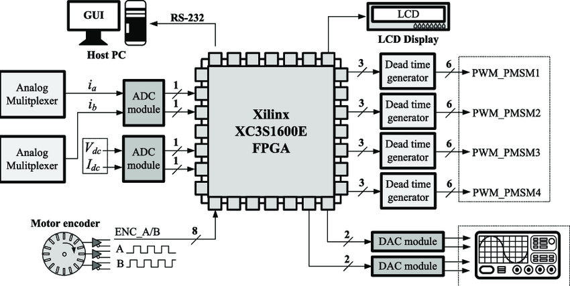
CIRCUIT DIAGRAM

Slide 8
WORKING
Create a new project in your FPGA design software, and select the FPGA board you are using as the target device.
Define the input and output ports of the comparator. In this case, you will have two 2-bit input ports (A and B), and one output port (Out) that will be used to indicate whether A is greater than, less than, or equal to B.
Write the VHDL or Verilog code for the 2-bit comparator. The code should compare the two input ports and set the output port to 00 if A is equal to B, 01 if A is greater than B, and 10 if A is less than B.
Once the code is written, synthesize and implement the design using the FPGA design software. This will create a bitstream that can be loaded onto the FPGA board.
Load the bitstream onto the FPGA board and test the 2-bit comparator using a suitable input stimulus. You can use the switches or buttons on the board to input values for A and B, and observe the output on the LEDs or displays.

Slide 9
APPLICATIONS
For Address decoding such as microprocessors, memory and input/output devices.
For Control logic- To compare two inputs and generate a control signal based on the comparison.
For Sorting networks- To compare two inputs and swap their positions if necessary.
For Error detection- To compare the expected and received data and detect errors.

Slide 10
ADVANTAGES
Relatively simple digital circuit.
Low power consumption.
Easily Flexible
Ensure compatibility with other components

Slide 11
LIMITATIONS
Limited input range
Limited precision
Limited scalability
High power consumption

Slide 12
CONCLUSION
A 2-bit comparator is a combinational logic circuit that compares two 2-bit binary numbers and determines whether they are equal, and if not, which one is greater.
To implement a 2-bit comparator, you can use logic gates such as AND, OR, XOR, and NOT gates. One common implementation is to compare the most significant bit (MSB) of the two input numbers first, and if they are equal, then compare the least significant bit (LSB).
2-bit comparator is a useful building block for larger digital circuits that involve comparing binary numbers. It can be implemented using logic gates and provides three output bits indicating the relationship between the two input numbers.

Slide 13
FUTURE SCOPE
As the demand for compact and efficient electronic devices continues to rise, IC manufacturers are likely to integrate 2-bit comparators into their designs to reduce the size and cost of the overall system.
2-bit comparators can be used in high-speed data communication applications such as Ethernet, where the circuitry must compare the incoming data with a pre-defined pattern to ensure data integrity.
As IoT devices become more prevalent, 2-bit comparators can be used to compare sensor data and trigger specific actions or alarms based on predefined conditions.
2-bit comparators can be used in the design of AI and ML systems, such as neural networks, where they can be used to compare and process input data.

Slide 14
REFERENCES
http://www.ijesi.org/papers/Vol(2)1%20(version%202)/C211324.
https://www.ripublication.com/ijaerspl2017/ijaerv12n1spl_102.
https://www.electronics-tutorials.ws/combination/comb_8.html

Slide 15
KCCEMSR, THANE
Thank You!!

